Slide 1





Investing Like A Star
Insights, conclusions, and practical actions for smart investment decisions
Data-driven recommendations based on IMDb insights and investor preferences
Stav Sivilya
Ziv Mordoch
Lotem Cohen
Omri Buhbut
Oria Yaakov

Slide 2
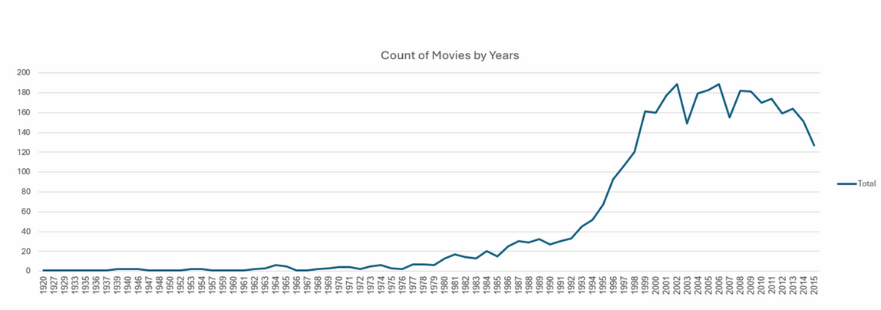
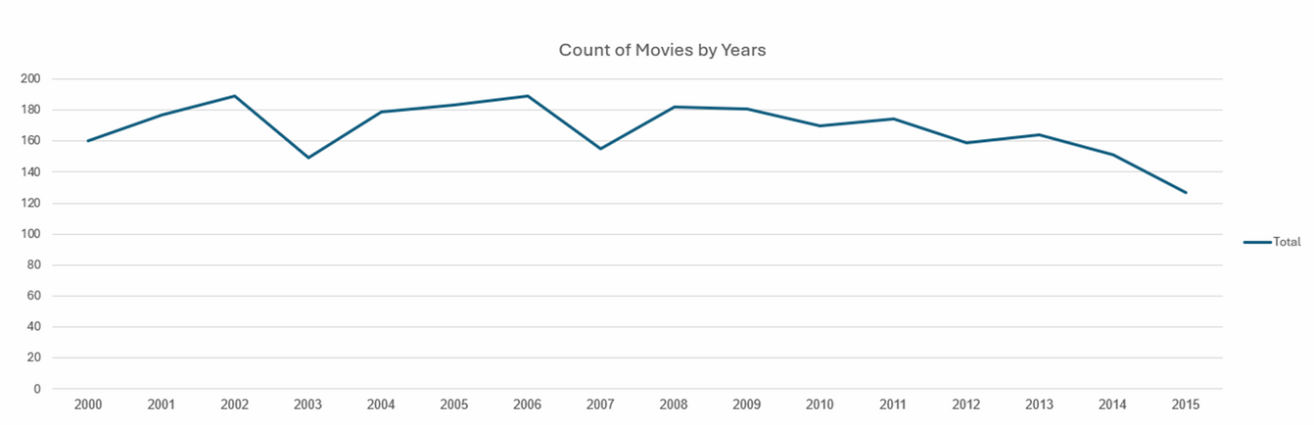
Our Focus: The 2000–2015 Film Market
Since IMDb launched in 1990 and contains very limited data from earlier years, we focused our analysis on films released between 2000 and 2015 to ensure greater reliability and consistency in the results.

Slide 3
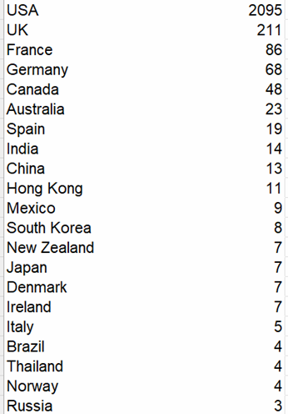
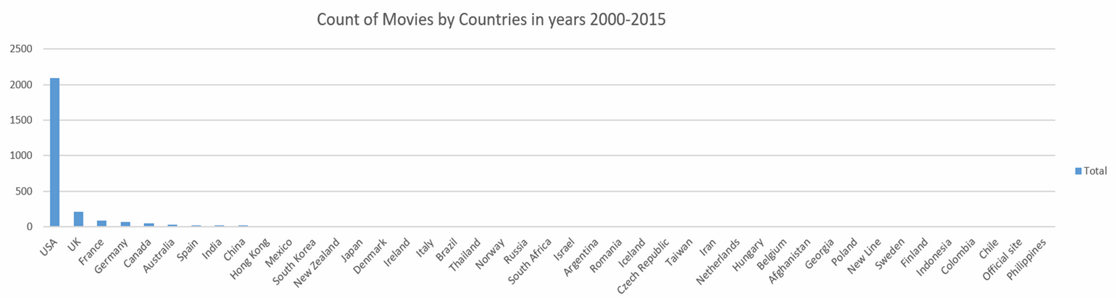
Market Focus: The U.S. Film Industry (2000–2015)
During 2000–2015, the U.S. shows the highest volume of film data on IMDb, making it the most reliable market for analysis, a focus that aligns with extensive research highlighting Hollywood’s long-standing dominance in global film markets.

Slide 4
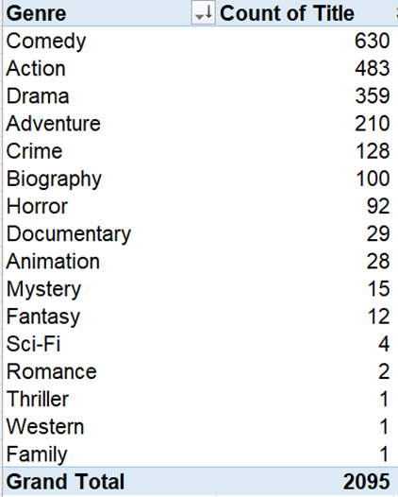
High-Volume Genres in the U.S. Film Market
We focus on genres with 90+ films released between 2000 and 2015 to base insights on consistent and reliable data.

Slide 5
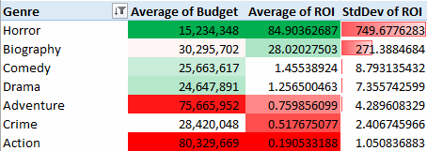
Analysis 1 - ROI by Genre
An analysis of ROI and risk levels (based on standard deviation) across selected genres in relation to production budget.
Horror and Biography delivers the highest ROI, but also carries a very high level of risk.
For investors with a medium budget and low risk appetite, Comedy and Drama offer the most stable options, with moderate budgets and consistent returns.

Slide 6
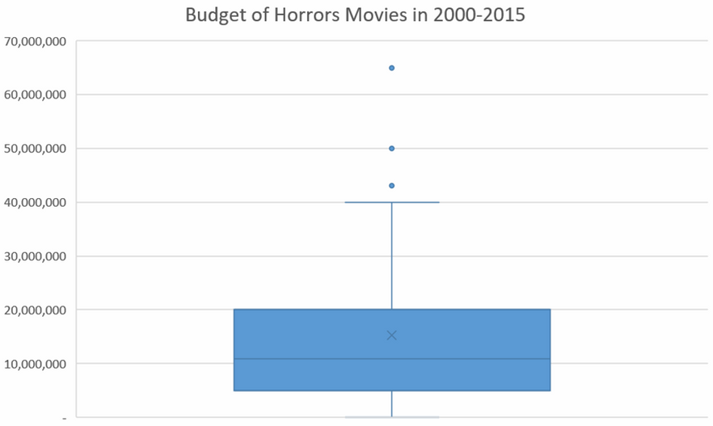
Analysis 1 - Deep Analysis
Following our supporting industry research, we shift our focus to Horror, the genre that consistently delivers strong returns with controlled budgets.
After excluding films with extreme budgets, Horror maintains a relatively high ROI while the risk level (STD) decreases significantly to a more reasonable range.
Conclusion: Horror films represent a strong and attractive investment opportunity.

Slide 7

Analysis 2 - Correlation between FB likes and ROI
Many investors associate social media popularity and engagement with a film’s success, so we examined the correlation between online popularity and ROI.
Contrary to common belief, our findings suggest that social media popularity is not a strong predictor of ROI.

Slide 8
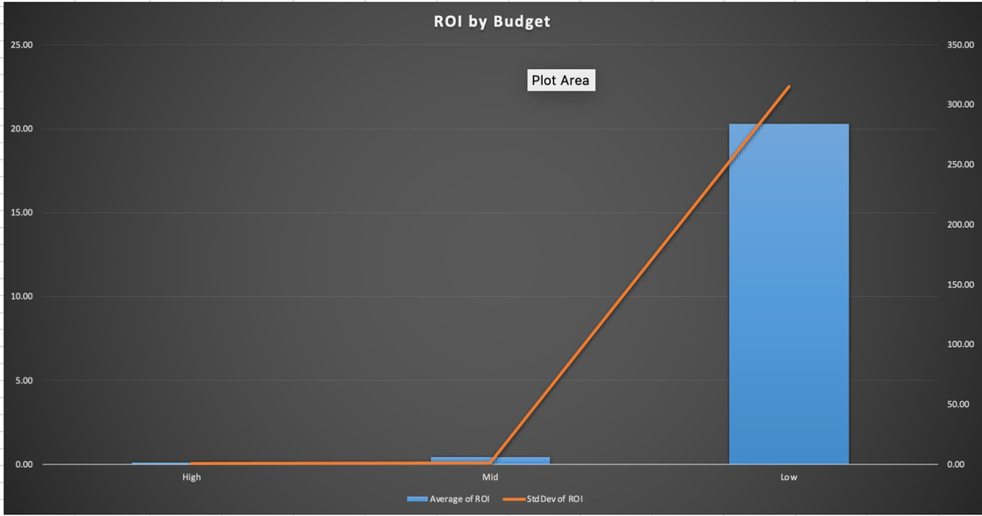
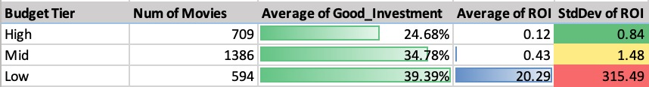
Analysis 3 - “Good Investment” by Budget tier
Analysis of ROI and risk by budget tier, showing the share of films classified as a “good investment” using a binary index (1 = ROI above 50%, 0 = otherwise), alongside average ROI and standard deviation.
Low-budget films can be a good investment but involve very high risk. Mid-budget films can also be a good investment, while carrying a much lower and more reasonable level of risk.

Slide 9
Recommendation
Certain genres consistently outperform others in ROI. After an in-depth analysis, the Horror genre stands out as an excellent investment channel with strong return potential.
Social media popularity should not be treated as a reliable predictor of ROI, as it demonstrates weak correlation with financial performance.
Budget level directly affects both return and risk. Low-budget films can be a good investment but carry high volatility, while mid-budget films maintain strong upside with a far more stable and reasonable risk profile.

Slide 10
Refferences
[1] V. Fernández Blanco, D. C. Chisholm, W. D. Walls, S. Abraham Ravid (2015). Economics of motion picture: the state of the art. Journal of Cultural Economics 39 pp. 1-13.
[2] N. Terry, R. King, J. J. Walker (2010). The Determinants of Box Office Revenue for Horror Movies. Journal of Global Business Management Vol 6. pp. 1-10.
[3] S. Follows (2017). How profitable are horror movies? https://stephenfollows.com/p/profitable-horror-movies

